Slide 2
Managing sugar-mill liquid effluent to zero discharge, a case study of Mehran Sugar Mills Limited
Sanaullah Mehran Sugar Mills Limited Sharif Khan Mirpurkhas Sugar Mills Limited

Slide 3
Outline
Introduction
Methodology
Effluent Flow reduction
Pollutant Reduction
Cost of ETP & EMP
Results & discussions
Future Work
Conclusion

Slide 4
INTRODUCTION
Sugar mill liquid effluents, containing high levels of pollutants, are a threat to our environment.
Though there are stringent rules and regulations for control of effluents. very few mills are currently addressing these issues.
Usually when the disposal of polluted effluent is not an issue or management is less concerned about the adverse environmental effects of discharging highly polluted effluent, effluent levels are high due to negligence.
Typically sugar mills generate effluents at the rate of 0.5 – 0.7 tons/tons cane.

Slide 5
INTRODUCTION
The management of MSM realized the adverse effect of generating polluting effluents and, considering its corporate social responsibility, decided to reduce the effluent flow and COD levels to meet the National Environmental Quality Standards (NEQS).
Mehran Sugar Mills Limited (MSM) started a campaign of reducing the quantity of its liquid effluents and their pollutant parameters in year 2012.
This paper describes the methodology, implementation, discussions and results of effective EMP at MSM.

Slide 6
METHODOLOGY
Pollutant | Unit | Factory raw effluent data (Base case)(2012-13) | NEQS standard
Effluent discharge flow | m³/h m³/day | 255 6116 | - -
Chemical oxygen demand (COD) | mg/L | 2980 | ≤150
Biological oxygen demand (BOD) | mg/L | 1100 | ≤80
Oil and grease | mg/L | 50 | ≤10
Total suspended solids | mg/L | 1375 | ≤200
pH | - | 5-8 | 6-9
The cost of an ETP for the base case effluent flow and pollutant concentration was about USD 1.7 million. The base case effluent data are given in Table 1.
As a logical strategy, it was decided to reduce effluent flow and COD levels to the minimum by improving manufacturing practices and other innovative solutions before installing any effluent treatment plant (ETP).

Slide 7
METHODOLOGY
A team was formed consisting of members from the mechanical, electrical, instrument, health safety and environment (HSE), laboratory and management departments headed by the Process Manager.
The team prepared a detailed Effluent Management Plan (EMP) for reducing the effluent flow and its pollutant concentration.
Given that expenditure needed to be utilized for other important projects, the EMP was phased in over three seasons.

Slide 8
METHODOLOGY
The object was to reduce effluent flow to a minimum value of 1000 from 6116 m³/day with less than 1000 ppm COD, to reduce the cost of the ETP, and to meet NEQS standards.
An additional object of the EMP was to simultaneously reduce canal water requirements for the mill. All projects were initiated relative to their impact on effluent flow and pollutant concentration.

Slide 9
METHODOLOGY
Effluent flow reduction
Sugar cane is a unique crop in that it brings all the elements required for sugar manufacturing along with the sugar,
Fiber for energy production
Water for processing
Because the cane supply comprised more than 70% water and less than this was required for mill operations, we developed the idea to replace canal water with cane water for all of the sugar-manufacturing processes.
Ideally, there is no need for additional water if cane water is utilized properly.

Slide 10
METHODOLOGY
Effluent flow reduction
Water circulation in the factory processes, such as condensate usage at mills for imbibition, for processing, for molasses dilution and for boilers as feed water, has less impact on effluent generation than draining cane water into drains and utilizing canal water for processing
Increased internal circulation of water decreases the plant steam energy efficiency and thus increases the plant steam requirement, but reduces effluent generation, as surplus condensates are reduced.
It is not economically wise to decrease the plant steam energy efficiency just to reduce effluents.

Slide 11
METHODOLOGY
Effluent flow reduction
The following methodology was adopted for reducing the effluent flow:
A water balance of the plant was carried out.
A list of water consuming and draining points was prepared. This was important to know the sources of canal water usage and water draining to effluent.
A list of all the municipal/sewage water points, including bathrooms, toilets and kitchen waters of the factory, was prepared for separate disposal to the nearby town’s municipal drain.
The philosophy of 5 Rs (Refuse, Reduce, Reuse, Repurpose and Recycle) was adopted for conservation of effluent.

Slide 12
METHODOLOGY
Effluent flow reduction
Water balance of the plant was developed for all the inflows and outflows. The basic equation of the factory water balance is:
Water In = Water out
Water In = Water in Cane + Water from other sources (canal/ground water)
Water Out = Water out from factory through product, by- product, evaporation and effluent.

Slide 13
METHODOLOGY
Water In |  | Water Out
Source | Quantity (t) | Source | Quantity (t) | % Cane
Cane | 6,927 | Evaporation through spray pond | 2,732 | 42.87
 |  | Water in bagasse | 1,588 | 24.92
 |  | Evaporation from boilers and gas scrubber | 1,000 | 15.69
 |  | Water in filter cake | 195 | 3.06
 |  | Evaporation from juice flash tank | 149 | 2.34
 |  | Evaporation from boiler blow-down | 115 | 1.80
 |  | Evaporation through steam leakage | 112 | 1.76
 |  | Water in boiler ash | 100 | 1.57
 |  | Evaporation through soda boiling | 100 | 1.57
 |  | Evaporation at mills | 100 | 1.57
 |  | Evaporation through NCG Steam | 82 | 1.29
 |  | Evaporation from molasses storage tank | 50 | 0.78
 |  | Water in molasses | 17 | 0.27
 |  | Evaporation from sugar dryer | 16 | 0.25
 |  | Evaporation through vertical crystallizer cooling tower | 16 | 0.25
 |  | Sugar | 1 | 0.02
 |  | Total | 6373 | 100
Canal/Ground Water | 5,562 | Effluent Water* | 6116
Total Water In | 12,489 | Total Water Out | 12,489
Effluent flow reduction
Table 2 describes all the water flows data of the factory for the base-case season of 2012-13.
* Factory municipal effluent is included.
The factory water balance showed that there was only 554 m³/day (6927-6373=554) surplus cane water, whereas effluent generation was about 6116 m³/day.
This indicated inefficient utilization of cane water and unwanted use of canal water for process or drainage of water in effluent.
If canal water is used for process the condensate will be in surplus by the same amount.
The canal water intake quantity was calculated to be 5562 m³/day.

Slide 14
METHODOLOGY
Canal water use as sprinkler water for boiler ash. | Canal water | Carried along with ash | Boiler blowdown water to be used for spraying on ash. | Carried along with ash
Boiler feed water sample point | Condensate water | Main drain | - | To be closed after sample.
Boiler No.1, 2, 3, 4 and 5Continuous blow down water | Condensate water | Main drain | - | This blowdown to be reduced by improved feed water quality. As it contains high TDS, it should be used as sprinkler water for ash.
Laboratory Waste
Laboratory bathroom | Canal water | Main drain. | Canal water | To be discharged in separate approved municipal drain.
Laboratory analysis water basins | Sugar containing water. | Main drain. | - | All the sample material should be collected separately and recycled at defecated juice tank.
Laboratory condensate sample water | Condensate | Main drain. | - | It should be diverted to spray pond.
Ground water
Tech: Mosque bathroom | Ground water | Main drain | - | To be collected separately and discharged in separate approved municipal drain.
Tech: Mosque floor washing | Ground water | Main drain
Workshop hand wash | Ground water | Main drain
Condensate / Hot Water
Vapor line juice heater | Condensate | Main drain |  | To be collected in under vacuum condensate tank of evaporators and used for process.
Exhaust and vapor condensate tank drain | Condensate | Main drain |  | Emergency drain in main drain, no effect on pollutant concentration.
Massecuite re-heater calorifier drain | Condensate | Main drain |  | This should be used at A-sugar remelter as it is near to this utility.
Feed water storage tanks Overflow | Condensate | Main drain |  | Simple automation can stop this overflow and this highly pure water could be used for heating of juice and imbibition purpose.
Process house hot water tank overflow | Condensate | Main drain |  | Overflow to be drained in spray pond
House/Equipment | Existing water source (canal or condensate) | Existing disposal method | Recommended source of water | Recommended disposal
Evaporator tube cleaning water | Canal water | Main drain | Surplus condensate to be used after cooling | To be collected separately and re-used at FARS as make-up water.
Raw and refinery pan tube cleaning water | Canal water | Main drain | Surplus condensate to be used after cooling
Spray channel overflow drain water | Canal water | Main drain |  | To be treated through ETP and uses as irrigation water.
V. filter cascade condenser water | Canal water | Main drain | Spray pond water to be used | Canal water to be replaced with spray pond water and recycled.
Nash pumps bearing cooling water | Canal water | Main drain | Surplus condensate to be used after cooling | To be collected and pumped to mills for imbibition.
Power house turbine cooling water | Canal water | Service water circulation tank | Already recycled through service water tank. | Already recycled through service water tank.
T.B Mill floor washing | Condensate and canal water | Main drain | Good housekeeping to be improved for reducing cleaning frequency. Only hot condensate to be used. | Good housekeeping to be improved for reducing cleaning frequency. Only hot condensate to be used.
T.B fibrizer bearing cooling water | Canal water | Main drain | Canal water | To be collected and recycled through service water tank.
Raw juice pumps floor washing | Condensate and canal water | Main drain | Good housekeeping to be improved for reducing cleaning frequency. Only hot condensate to be used. | Good housekeeping to be improved for reducing cleaning frequency. Only hot condensate to be used.
T.B imbibition tank overflow | 50 % Condensate and 50 % canal water | Main drain | Hot Condensate after heating juice to be used. | Mechanical float valve or electronic auto control to be provided to stop tank overflow.
T.A Platform washing | Condensate and canal water | Main drain | Good housekeeping to be improved for reducing cleaning frequency. Only hot condensate to be used. | Good housekeeping to be improved for reducing cleaning frequency. Only hot condensate to be used.
M.Turbine bearing cooling water | Canal water | Main drain/service water tank | Canal water | Discharge to main drain to be stopped and 100 % recycle of water to be ensured.
Mill Max Drive side bearing cooling water | Canal water | Main drain/service water tank
Mill Max bearing cooling water | Canal water | Main drain/service water tank
Mill Max, nozzle plate washing water. | Canal water | Mixed with juice | Screened juice | Canal water to be replaced with screened mixed juice as per original design.
Mill Max gear bearing cooling water | Canal water | Main drain | Canal water | To be collected and recycled through service water tank.
T.B. Mill bearing cooling water | Canal water | Main drain/service water tank | Canal water | Discharge to main drain to be stopped and 100 % recycle of water to be ensured.
T.A Fibrizer bearing cooling water | Canal water | Main drain. | Canal water | To be collected and recycled through service water tank.
T.A imbibition tank overflow | Condensate + canal water | Main drain. | Hot condensate after heating juice to be used. | Mechanical float valve or electronic auto control to be provided to stop tank overflow.
T.A Mill gear bearing cooling water | Canal water | Service water tank | Canal water | Already recycled through service water tank.
T.A. Mill bearing cooling water | Canal water | Main drain/service water tank | Canal water | Discharge to main drain to be stopped and 100 % recycle of water to be ensured.
Boiler ID and Sec: Fan bearing cooling water | Canal water | Main drain | Canal water | To be collected and recycled through service water tank.
Feed pump No.1bearing cooling water | Canal water | Main drain
Feed pump bearing cooling water | Canal water | Main drain
Effluent flow reduction
A list of water-consuming areas with their water sources was prepared to quantify and identify water consumption and its source.
This list also identified the areas of water draining to effluent. it is attached with paper as Appendix -1.
The water balance of the factory showed that the amount of water carried into the factory through cane exceeds the amount of water that exits from the factory through products, by-products and vapors. Ideally, only surplus cane water should be the part of effluent.
To maintain the required sanitation standards, washing of house floors is required and this surplus cane water could be used there. Condensate water, which is cane water (if no canal water is used in process), could be efficiently utilized for process operations

Slide 15
METHODOLOGY
Effluent flow reduction
The following innovative solutions have been successfully implemented at MSM for problematic areas to replace canal water:
Mills imbibition water. After heat recovery of process condensate water (through condensate juice heater) it was used for mill imbibition. The temperature of this condensate was reduced to 65°C, which is considered ideal for mill imbibition. Canal water used for imbibition was replaced with cane water.
Boiler blowdown water. This water, which is high in solids and could not be used for processing, was sprayed onto dry fly ash from the mechanical ash collectors of the boilers. The quantity of blowdown water was reduced by improving process condensate quality. Suitable de-entrainment devices were installed at the evaporators to improve the condensate quality.

Slide 16
METHODOLOGY
Effluent flow reduction
All the surplus condensates were cooled at a cooling tower and this cooled condensate was used for following applications:
All the process chemicals were prepared using this condensate, replacing canal water usage.
Canal water used for sealing water of Nash vacuum pumps was replaced with cold condensate. This water, after the Nash pump, was collected and pumped to mill house for imbibition.
Tube cleaning of all the evaporators, pans and juice heater was done with cold condensate. This scale-containing water is reused in the boiler flue gas-scrubbing system as makeup water. The scale is then removed from boiler scrubbing system along with boiler ash. These residues were disposed of into cane fields along with mill mud as a fertilizer.

Slide 17
METHODOLOGY
Effluent flow reduction
Vacuum filter cascade condenser water. Previously, canal water was used for this condenser and drained to the main drain. It was replaced with spray pond water and recycled.
Shell testing of vessels. Previously, shell testing of all the vessels was done with canal water and drained to the main drain. This was replaced with spray pond water and recycled. These vessels were then rinsed with hot condensate and also drained to the spray pond.
All the unwanted water taps of the process house were plugged, as they were sources of effluents.

Slide 18
METHODOLOGY
Effluent flow reduction
Caustic soda solution used for evaporator chemical cleaning was reused. Exhausted soda solution was then collected in a neutralization tank where it was neutralized with acid solution that had been used for first-effect chemical cleaning. This neutralized salt solution was drained to the effluent.
Water addition to various magmas in the raw and refining houses was replaced with clear juice and fine liquor.

Slide 19
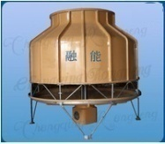
Effluent Status, Base Case, (2012-13)
(EMP, Phase-I)
(EMP, Phase-III)
(EMP, Phase-II)
Effluent Status After Phase-II, (2014-15)
Effluent Status After Phase-III, (2015-16)
Effluent Status After Phase-I, (2013-14)
Cane Water 6927 T/D
Cane Water 7067 T/D
Cane Water 7009 T/D
Canal Water 5562 T/D
Cane Water 7051 T/D
Canal Water 2412 T/D (57 % Saving)
Canal Water 1320 T/D (76 % Saving)
Canal Water 1665 T/D (70 % Saving)
Spray pond
Imb: water
Mills Green Belts & Mango Farm
Mills Bearing
Water out 7290 T/D
Water out 6645 T/D
Water out 7169 T/D
Water out 6373 T/D
Ash Carrier
Disposed
Fly Ash Scruber
Cas: Condenser
Shell Testing
Tube Cleaning
Damper Wash
Blow down
Effluent 6116
Effluent 2834 T/D
(54 % Saving)
Effluent 1081 T/D
(82 % Saving)
Effluent 1505 T/D
(75 % Saving)
Boiler & Tank
Chemical Preparation
Imbibition
1652 T/D
N.Pump Seal Water
Municipal Water

Slide 20
METHODOLOGY
Pollutant Reduction
The best way for reducing pollutant concentration is to plug the source.
Where it was not possible to collect the pollutant materials (usually process material), it was collected in sumps and reprocessed at appropriate stages of the process.
Juice drainage to effluent. Good equipment maintenance reduced juice leakages. Juice collection sumps were provided at all the juice, liquor and molasses pumping stations. The collected material was pumped to the defecated juice tank, where it was heated to 105°C before sending it to the juice clarifier. To maintain good sanitation conditions in the sumps, a biocide (sodium dithiocabamate) was used after hot water cleaning of the sumps; this was carried out daily.

Slide 21
METHODOLOGY
Pollutant Reduction
De-entrainment devices of evaporators and pans were modified to centrifugal vane type separators. This modification reduced the contamination of juice in condensate and contamination of spray pond water.
Data was collected for storage tank overflow incidents. Automation was provided at the clear and defecated juice tanks with local level display for operators. These eliminated tank overflows.
All the open channels of house main drains were covered to prevent mixing of suspended solids, especially bagasse which spreads due to its open storage.
Oil spillage to effluent. Good equipment maintenance significantly reduced oil leakages. An oil skimmer was installed at the main effluent stream of the mill house to collect any oil contamination in effluents.

Slide 22
RESULTS & DISCUSSIONS
Pollutant | Unit | Factory effluent data (Base case)(2012-13) | NEQS Standard | Factory effluent data (after EMP)(2015-16)
Effluent discharge flow | m³/h m³/day | 255 6116 | - | 45 1081
Chemical oxygen demand (COD) | mg/L | 2980 | ≤150 | 1845
Biological oxygen demand (BOD) | mg/L | 1100 | ≤80 | 710
Oil and grease | mg/L | 50 | ≤10 | 20
Total suspended solids | mg/L | 1375 | ≤200 | 167
pH | - | 5-8 | 6-9 | 6.5
It took 3 years to complete the project of EMP, resulting in the season 2015-16 data presented at Table 1.
Figure 1 shows the gradual progress of effluent flow reduction for the three seasons of EMP.
Figure 2 shows the gradual reduction of canal water intake to the factory for three seasons of EMP.
Figure 3 shows the average annual effluent and intake water flow comparison of the base case season 2012-13 with each of the three seasons of EMP.

Slide 23
RESULTS & DISCISSIONS
Summary of Results
The results of implementation of the EMP over the three years can be summarized as:
Effluent flow was reduced from 6116 m³/day to 1,081 m³/day or 0.095 tons/tons cane against industries average of 0.5 – 0.7. A reduction of 82.3% was achieved against the target of 83.7%.
COD loading was reduced by 88% against the target of 95%.
All other pollutant parameters were reduced significantly.
The cost of the proposed ETP was reduced from USD 1.7 million to USD 0.6 million, due to the reduction in effluent flow and pollutant loadings.

Slide 24
RESULTS & DISCISSIONS
Summary of Results
The results of implementation of the EMP over the three years can be summarized as:
The factory is installing an ETP, will be operational by season 2016-17 to meet NEQS standards.
Canal water was reduced from 5562 m³/day to 1320 m³/day, or over the 105 days of mill operation ,450,000 m³/year. This saved canal water is now available for the inhabitants at the tail end of this canal. In Pakistan where per capita water availability is less than 1000 m³, the quantity of this saved water is sufficient for a village of 450 inhabitants.

Slide 25
RESULTS & DISCISSIONS
Summary of Results
Mills achieved the targets to a great extent. Effluent flow was reduced by 82% against a target of 84%, and COD load reductions were 89% against a target of 95%.
Although we could not achieve NEQS standards due to higher-than-target COD, BOD and oil and grease levels, we were able to achieve our target of reducing effluent flow and pollutant concentrations and reducing the cost of the proposed ETP.

Slide 26
Cost of ETP & EMP Phases
Cost of ETP, base case (before EMP) and modified case (after EMP)
Base Case Cost = 178.50 million PKR
Modified Case Cost = 63.00 million PKR
Cost of EMP Phases = 30.00 million PKR

Slide 27
FUTURE WORK
The major source of effluent and pollutant is the overflow of spray pond water. This water becomes heavily polluted due to the exhaustive recirculation and entrainment from the pans. If a factory has enough water to pass through the pans and evaporator condenser only once, then the pollutant overflow of spray pond could be avoided. Fortunately, our factory is located very adjacent to an irrigation water canal and we are trying to convince the local authority to allow a one pass of canal water from the condenser, i.e. pumping water from the canal for a single passage through the condensers and discharging it back into the canal. If this is allowed, then not only power for spray pond water could be saved but also about 30% of the cane water from condensed vapors would be available for irrigation. For 1.0 million ton cane crushing, this cane water comes to 300,000 t of water annually.

Slide 28
CONCLUSION
Sugar mills, which are typically considered to be a source of pollutant effluents, are environment friendly industries, unless we pollute the environment.
We can significantly reduce the effluent flow, to a reasonably low limit, by improved manufacturing practices and innovative solutions, suitable for their own operating conditions.
Preparation and then implementation of an Effluent Management Plan (EMP) is the key for success.
Any reduction of effluent flow, saves clean canal water by the same amount, which then becomes available for other useful purposes.

Slide 29
Mehran Sugar Mills believes that every drop of canal water conserved at Mills would be available at tail end for useful purposes.

Slide 30
Acknowledgement
Authors are cordially thankful of our Worthy Managing Director and Resident Director Sb for their support and encouragement. We are also very much grateful of Technical Team of Mehran Sugar Mills Limited for their valued input and practical implementation of EMP.

Slide 31
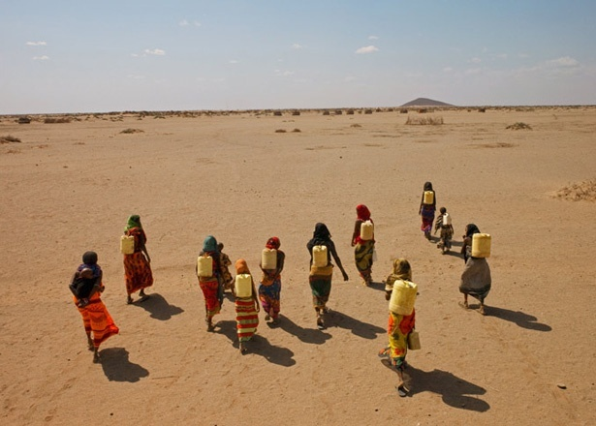
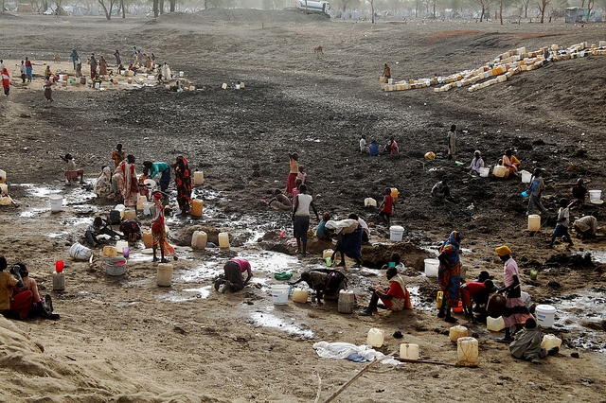
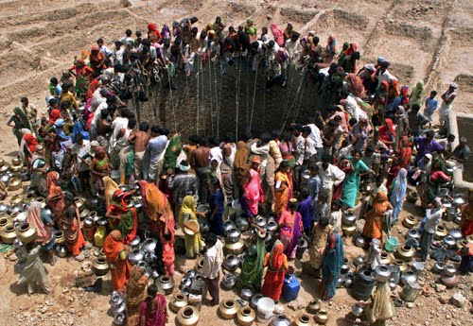
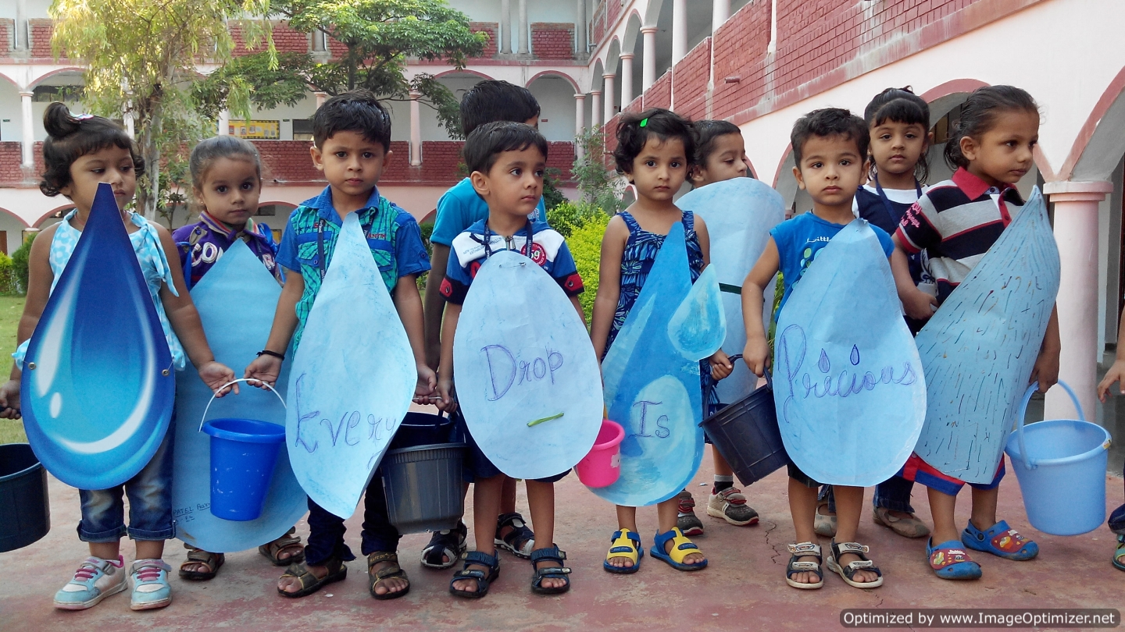
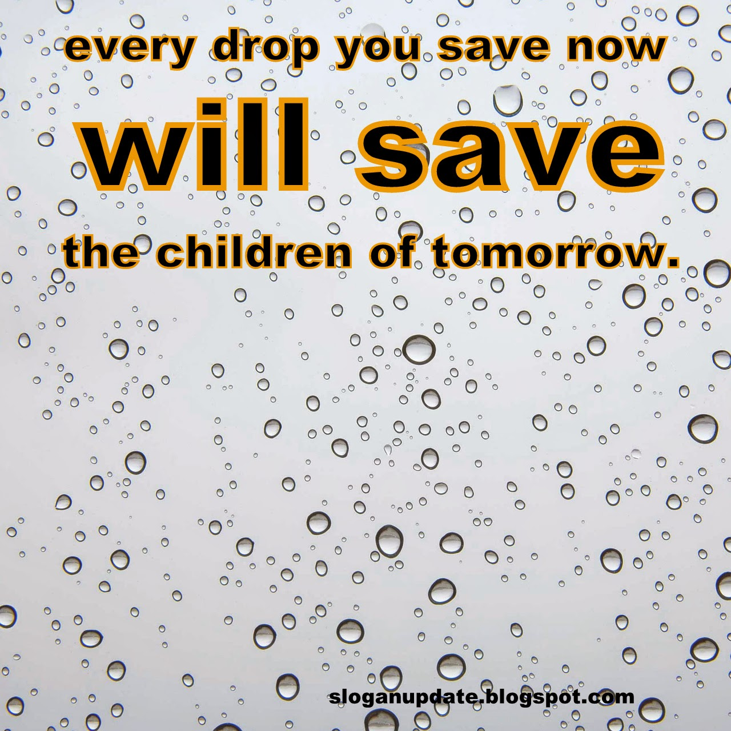
P L A N E T
O U R
S A V E

